Slide 1


Search for an exotic Higgs boson decay to two pseudoscalar bosons with a four photon final state Oral Candidacy Proposal December 13, 2023
Sergi Castells
Advisors: Colin Jessop and Nancy Marinelli

Slide 2
Outline
The Standard Model and Beyond
LHC and CMS
Introduction to Analysis
Sample Generation
Event Selection
Statistical Analysis
Advancements on Previous Studies
Summary
Notes:
Introduction – what am I doing? Basic why is it interesting?
The Standard Model and Beyond – theory stuff
LHC and CMS – also mention service work here briefly
Sample Generation – signal MC and event mixing part
Event Selection – cuts, BDT, categorization
Statistical Analysis – signal modelling + note on background fits
Advancements on Previous Studies – exactly what it sounds like
Summary – put everything together for questions
REMEMBER TO INCLUDE PLOTS!!!!!!!

Slide 3
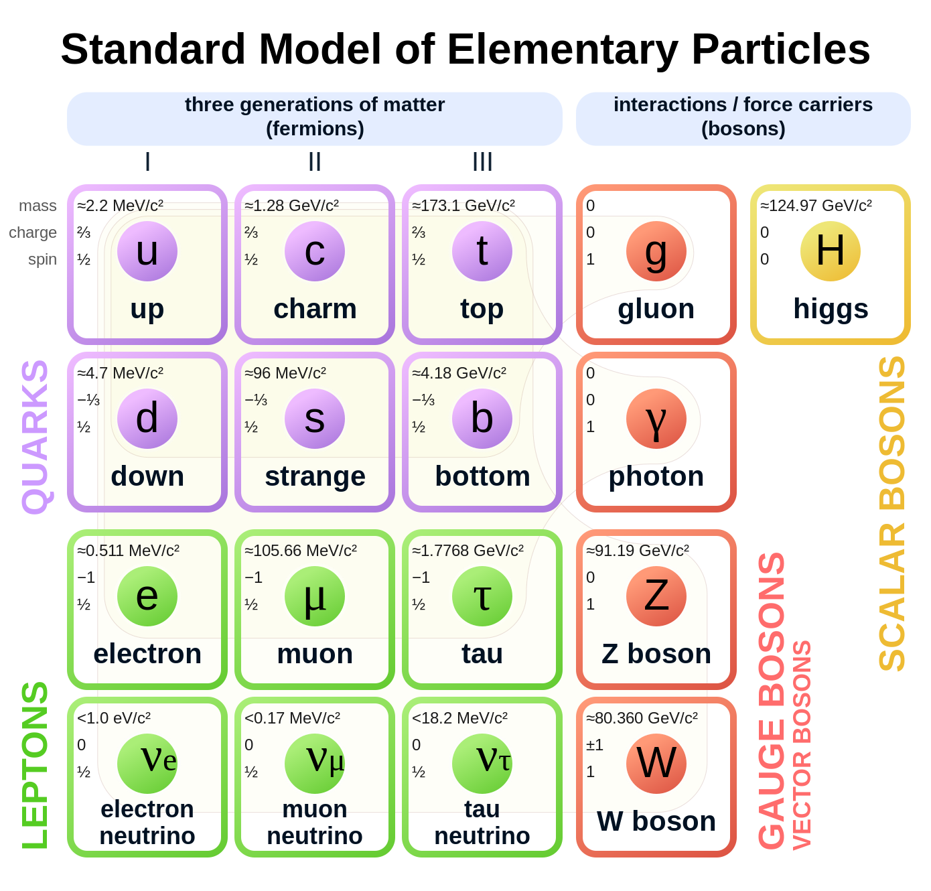
The Standard Model and Beyond
Most complete model of particle physics that describes all known elementary particles.
Describes three fundamental interactions:
Weak
Strong
Electromagnetic
Rich Higgs sector phenomenology:
Higgs mechanism yields gauge boson masses
Higgs VEV & Yukawa couplings yield other particle masses
Beyond the Standard Model physics can remedy its shortcomings and predict interesting, new physics.

Slide 4
Outline
The Standard Model and Beyond
LHC and CMS
Introduction to Analysis
Sample Generation
Event Selection
Statistical Analysis
Advancements on Previous Studies
Summary
Notes:
Introduction – what am I doing? Basic why is it interesting?
The Standard Model and Beyond – theory stuff
LHC and CMS – also mention service work here briefly
Sample Generation – signal MC and event mixing part
Event Selection – cuts, BDT, categorization
Statistical Analysis – signal modelling + note on background fits
Advancements on Previous Studies – exactly what it sounds like
Summary – put everything together for questions
REMEMBER TO INCLUDE PLOTS!!!!!!!

Slide 5
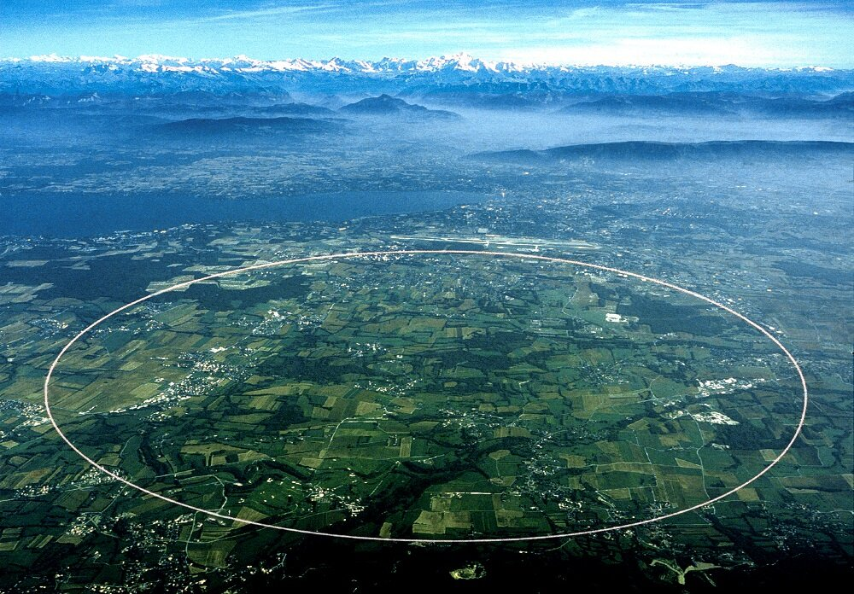
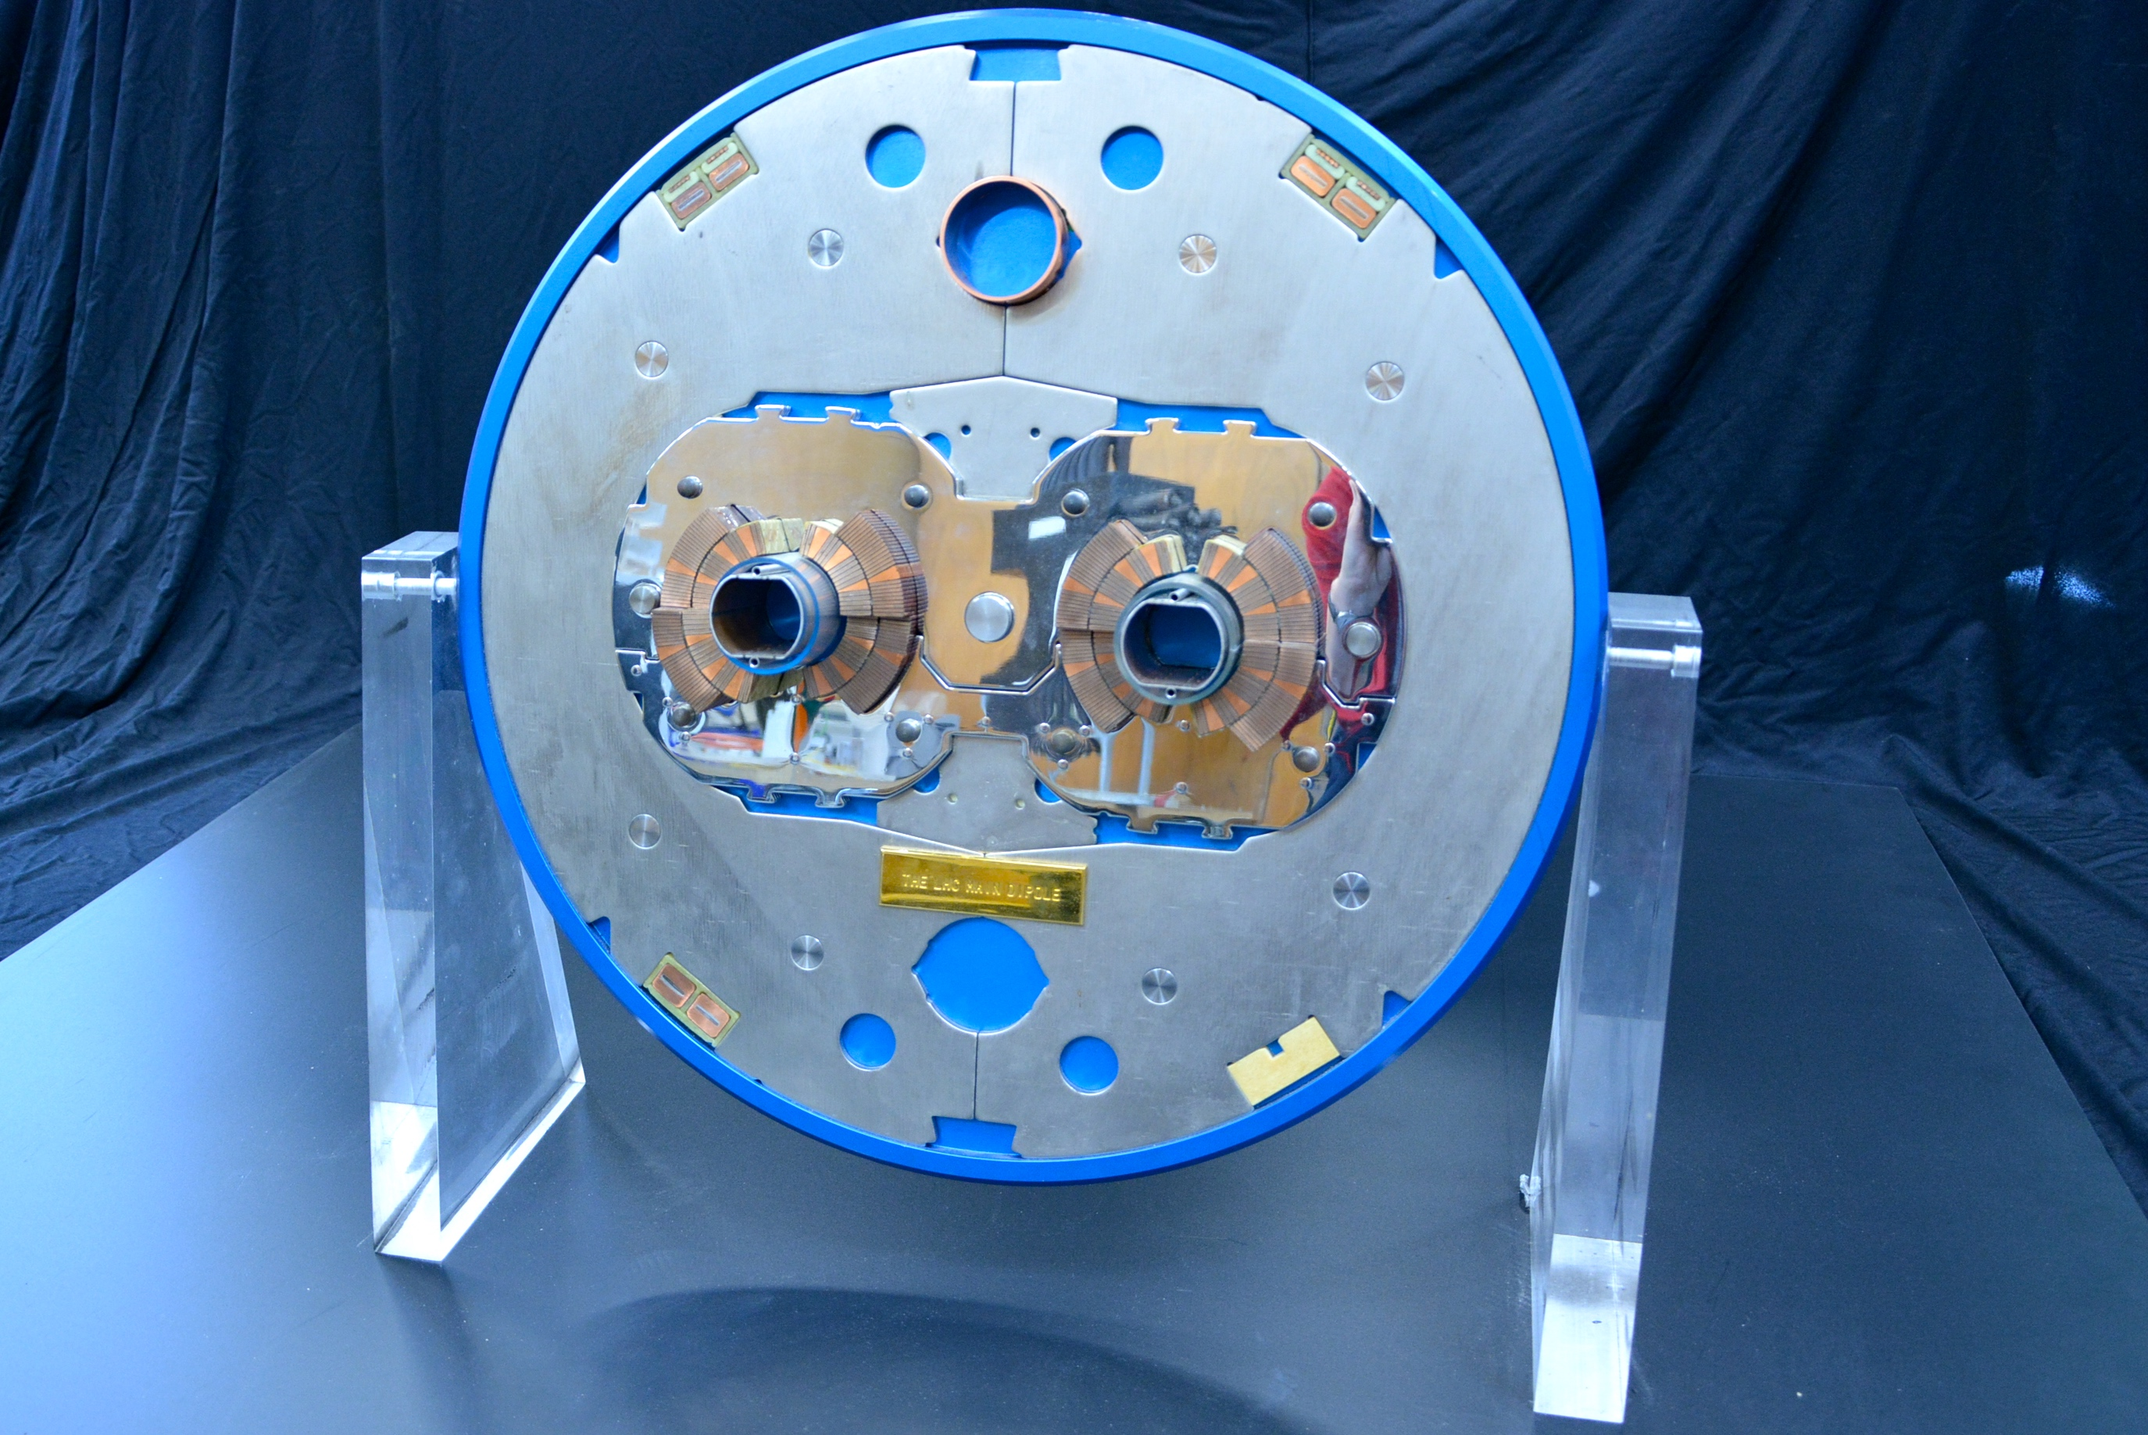
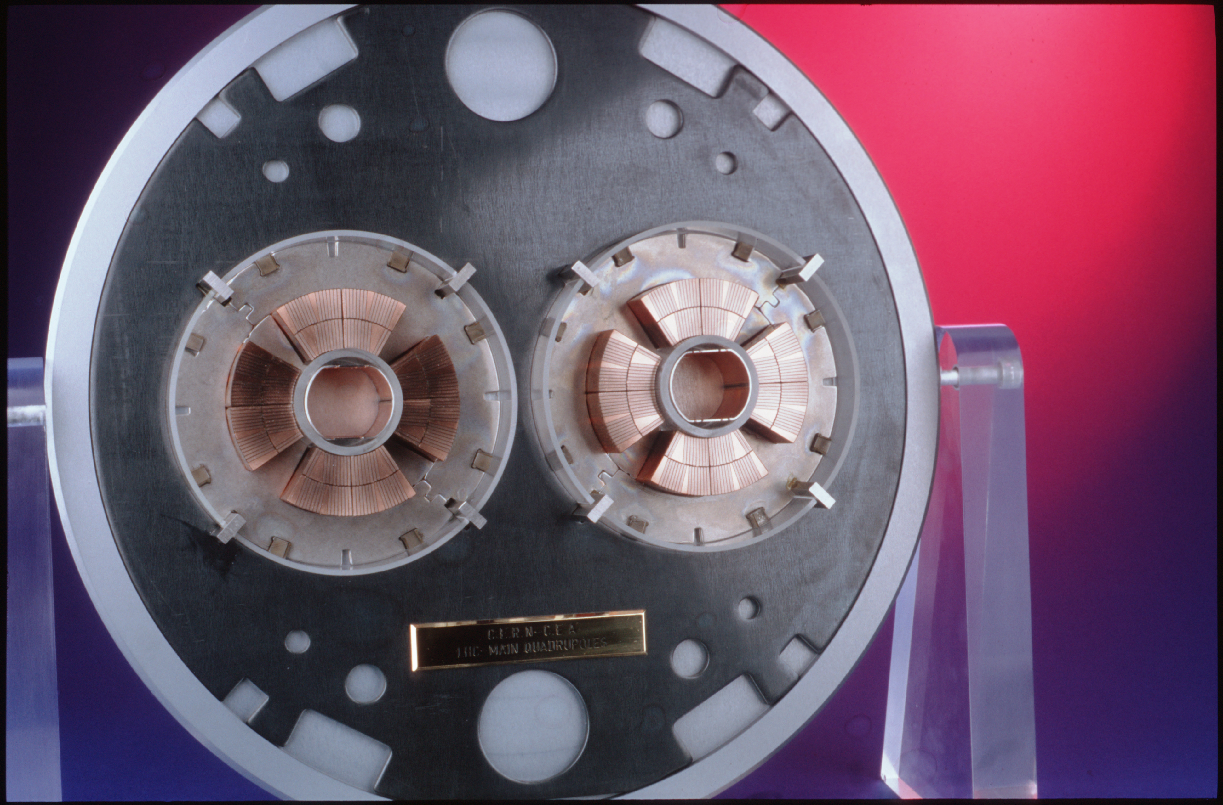
The Large Hadron Collider (LHC)
The LHC is the world’s largest particle accelerator, located on the border of France and Switzerland.
It is 27 km in circumference and operates at a center-of-mass energy of 13.6 TeV.
Superconducting dipole and quadrupole magnets bend and squeeze the proton beams, respectively. Additional multipole magnets are used to correct the beam.
The LHC can achieve a nominal instantaneous luminosity of 10³³ cm⁻² s⁻¹.
Four detectors along beamline:
General purpose: CMS and ATLAS
Specialized: ALICE and LHCb
Above: Slice of LHC dipole magnets.
Below: Slice of LHC quadrupole magnets

Slide 6
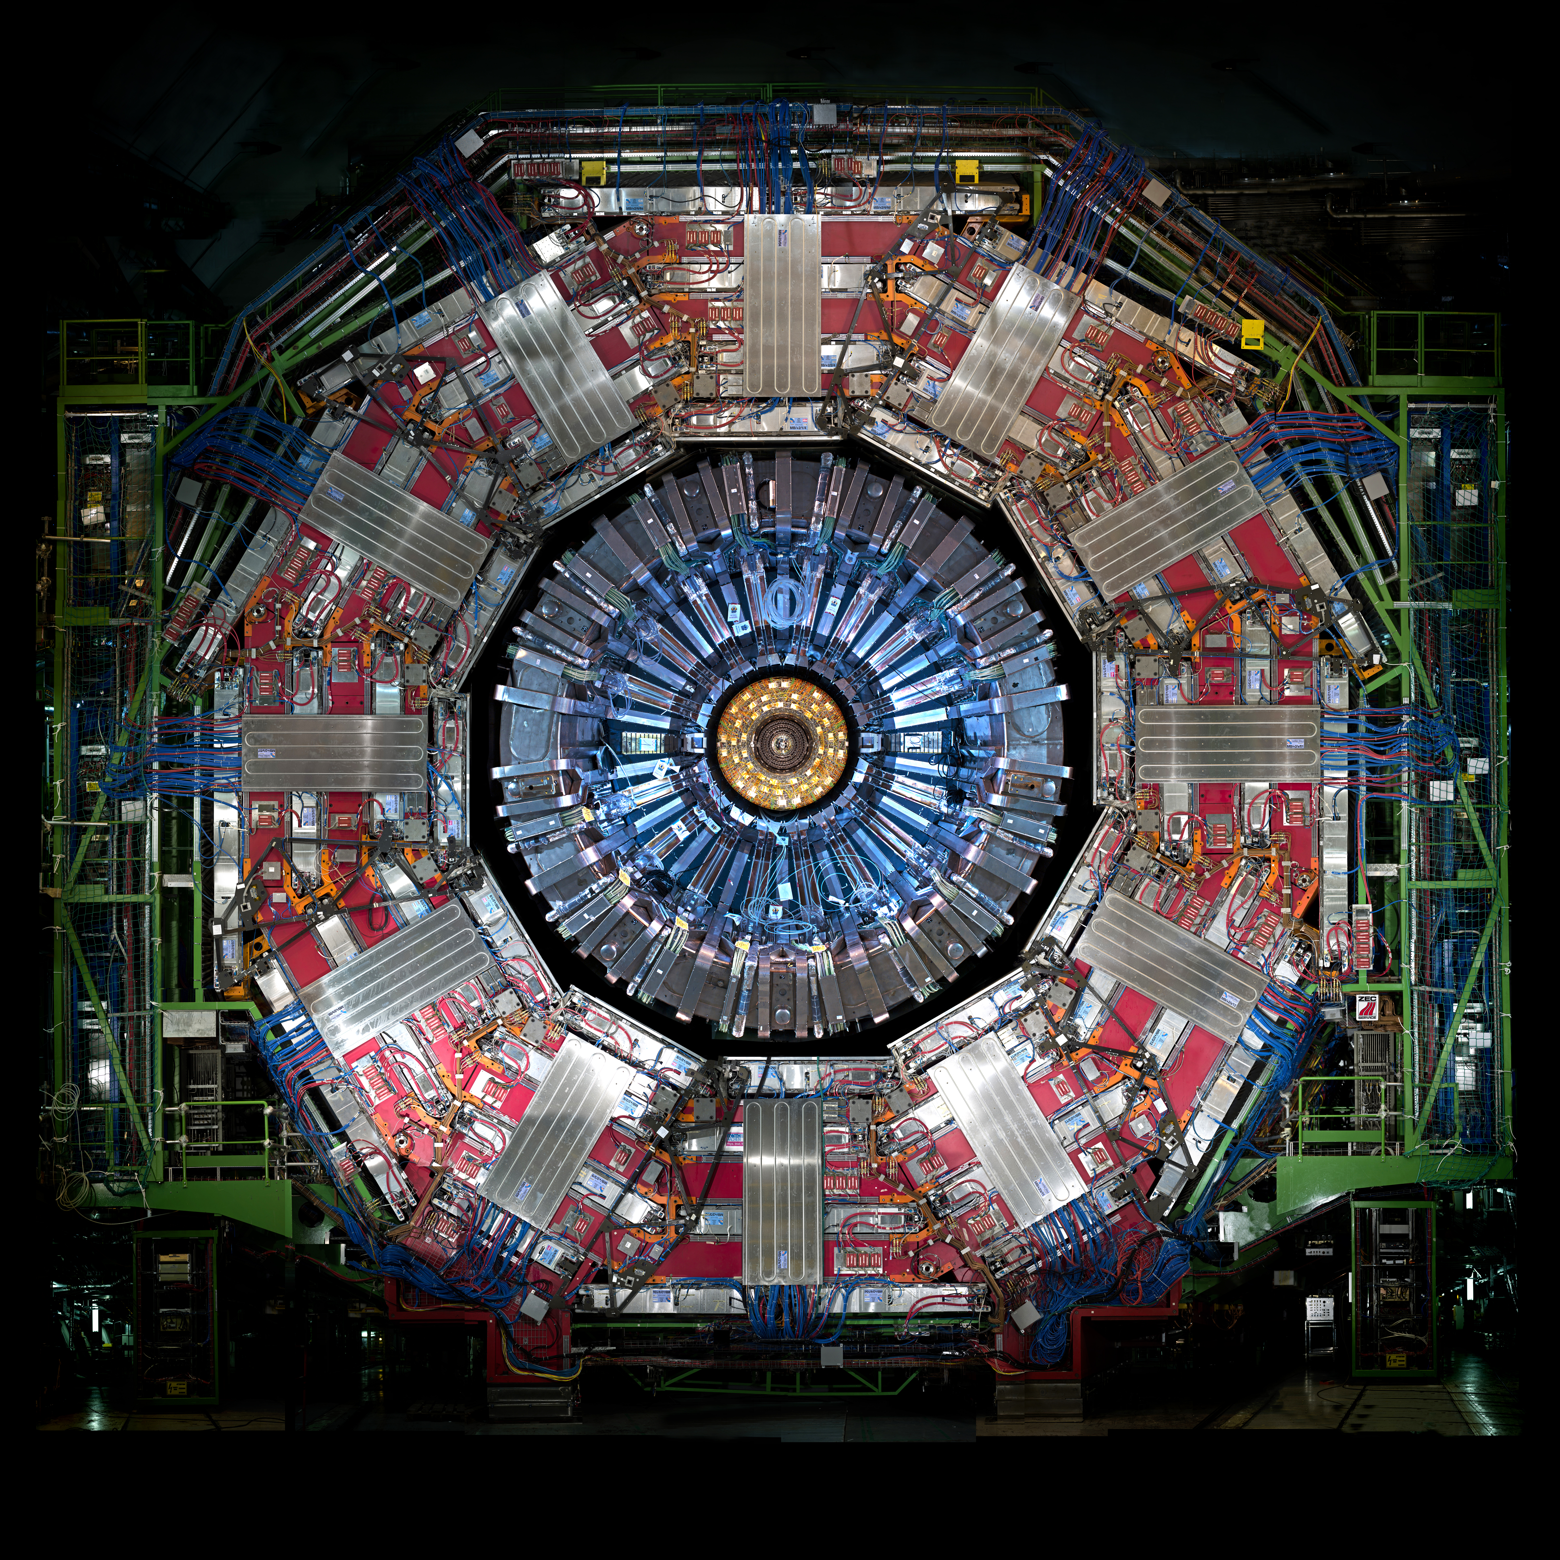
Compact Muon Solenoid (CMS)
Silicon tracker
Solid-state pixel and strip detectors
Detects charged particle tracks
Electromagnetic calorimeter (ECAL)
Homogenous detector
Consists of 75,000 PbWO₄ crystals
Stops and detects electromagnetically charged particle showers
Hadronic calorimeter (HCAL)
Sampling calorimeter
Layers of plastic scintillator and brass absorbers
Stops and detects neutral and charged hadrons
Solenoid Magnet
Bends charged particles to measure momentum
Muon chambers
Stops and detects muons
Notes:
Sampling vs Homogenous are two the different types of calorimeters. Sampling is like the HCAL where two materials alternate to cause showers and measure the decays. Homogeneous calorimeters are made of one material that both causes and measures the particle shower (e.g. ECAL).

Slide 7
Outline
The Standard Model and Beyond
LHC and CMS
Introduction to Analysis
Sample Generation
Event Selection
Statistical Analysis
Advancements on Previous Studies
Summary
Notes:
Introduction – what am I doing? Basic why is it interesting?
The Standard Model and Beyond – theory stuff
LHC and CMS – also mention service work here briefly
Sample Generation – signal MC and event mixing part
Event Selection – cuts, BDT, categorization
Statistical Analysis – signal modelling + note on background fits
Advancements on Previous Studies – exactly what it sounds like
Summary – put everything together for questions
REMEMBER TO INCLUDE PLOTS!!!!!!!

Slide 8
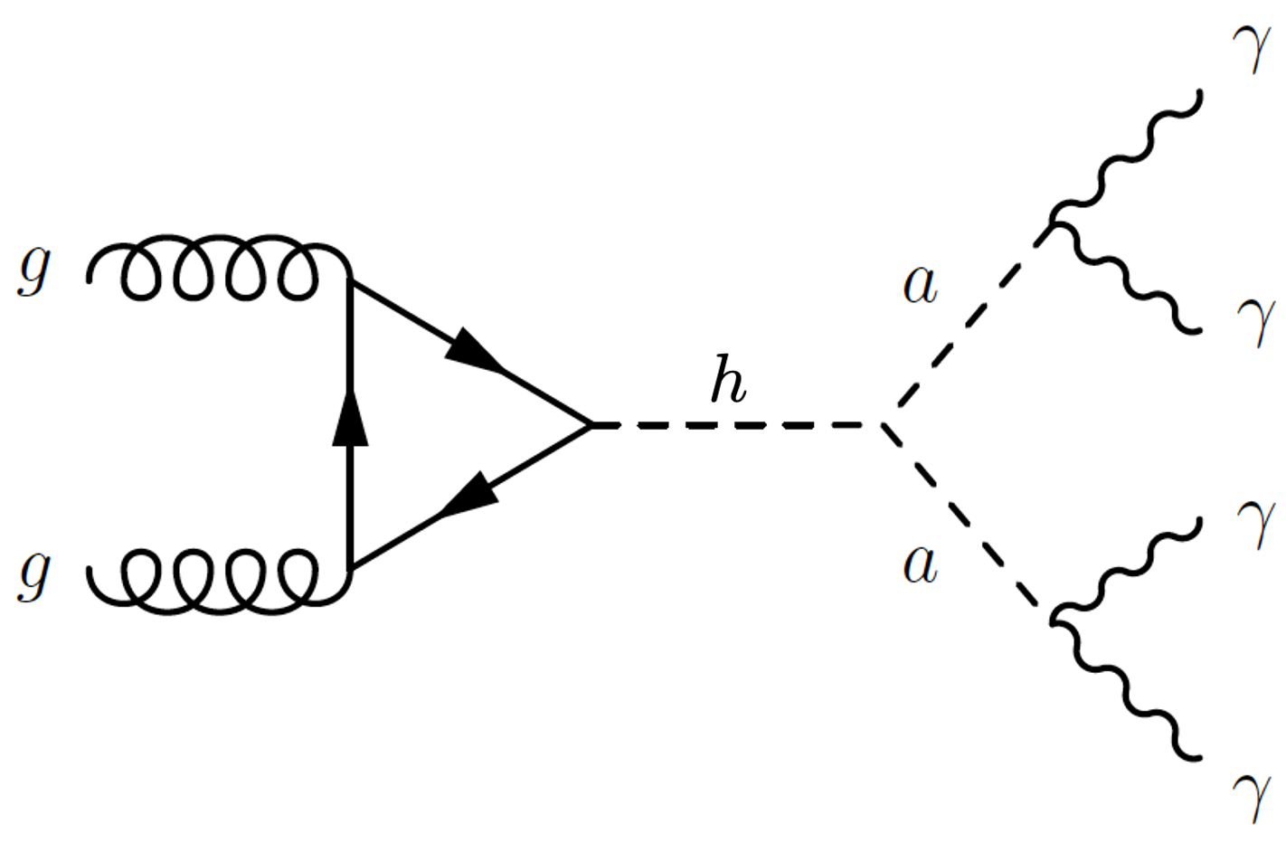
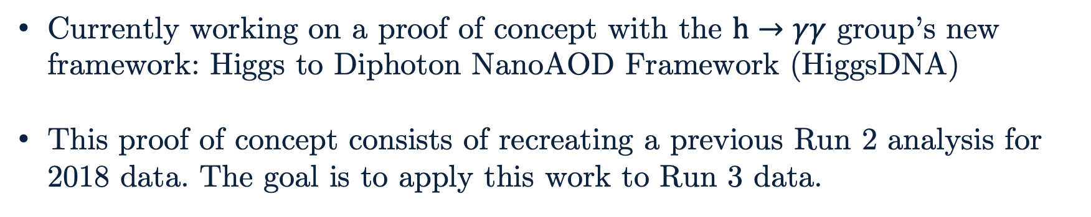
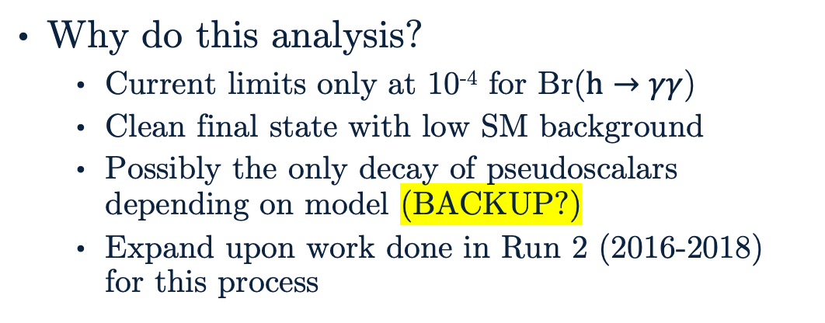
Introduction to Analysis
Why do this analysis?
Current limits only at 10⁻⁴ for Br($h→γγ$)
Clean final state with low SM background
Possibly the only decay of pseudoscalars depending on model (BACKUP?)
Expand upon work done in Run 2 (2016-2018) for this process
Currently working on a proof of concept with the $h→γγ$ group’s new framework: Higgs to Diphoton NanoAOD Framework (HiggsDNA)
This proof of concept consists of recreating a previous Run 2 analysis for 2018 data. The goal is to apply this work to Run 3 data.

Slide 9
Outline
The Standard Model and Beyond
LHC and CMS
Introduction to Analysis
Sample Generation
Event Selection
Statistical Analysis
Advancements on Previous Studies
Summary
Notes:
Introduction – what am I doing? Basic why is it interesting?
The Standard Model and Beyond – theory stuff
LHC and CMS – also mention service work here briefly
Sample Generation – signal MC and event mixing part
Event Selection – cuts, BDT, categorization
Statistical Analysis – signal modelling + note on background fits
Advancements on Previous Studies – exactly what it sounds like
Summary – put everything together for questions
REMEMBER TO INCLUDE PLOTS!!!!!!!

Slide 10
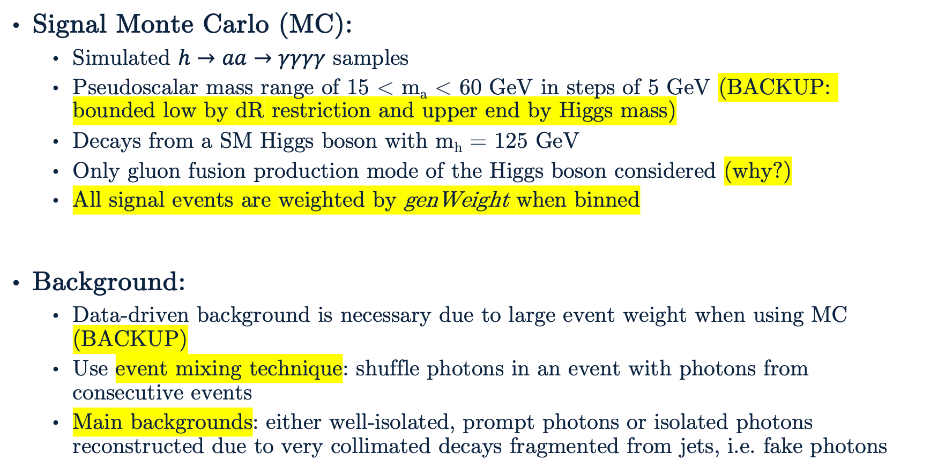
Sample Generation
Signal Monte Carlo (MC):
Simulated $h→aa→γγγγ$ samples
Pseudoscalar mass range of 15 < m_{a} < 60 GeV in steps of 5 GeV (BACKUP: bounded low by dR restriction and upper end by Higgs mass)
Decays from a SM Higgs boson with m_{h} = 125 GeV
Only gluon fusion production mode of the Higgs boson considered (why?)
All signal events are weighted by genWeight when binned
Background:
Data-driven background is necessary due to large event weight when using MC (BACKUP)
Use event mixing technique: shuffle photons in an event with photons from consecutive events
Main backgrounds: either well-isolated, prompt photons or isolated photons reconstructed due to very collimated decays fragmented from jets, i.e. fake photons

Slide 11
Outline
The Standard Model and Beyond
LHC and CMS
Introduction to Analysis
Sample Generation
Event Selection
Statistical Analysis
Advancements on Previous Studies
Summary
Notes:
Introduction – what am I doing? Basic why is it interesting?
The Standard Model and Beyond – theory stuff
LHC and CMS – also mention service work here briefly
Sample Generation – signal MC and event mixing part
Event Selection – cuts, BDT, categorization
Statistical Analysis – signal modelling + note on background fits
Advancements on Previous Studies – exactly what it sounds like
Summary – put everything together for questions
REMEMBER TO INCLUDE PLOTS!!!!!!!

Slide 12
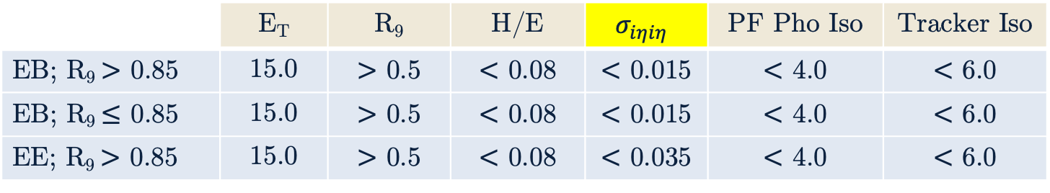
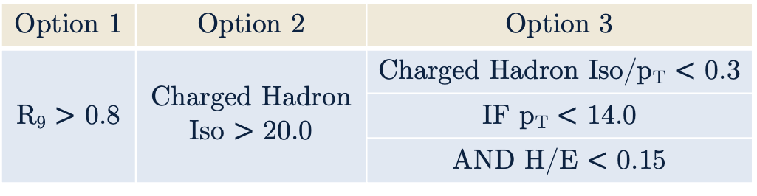
Pre-selections
 | E_{T} | R₉ | H/E | $$σ_{iηiη}$$ | PF Pho Iso | Tracker Iso
EB; R₉ $>$ 0.85 | 15.0 | $>$ 0.5 | $<$ 0.08 | $<$ 0.015 | $<$ 4.0 | $<$ 6.0
EB; R₉ $≤$ 0.85 | 15.0 | $>$ 0.5 | $<$ 0.08 | $<$ 0.015 | $<$ 4.0 | $<$ 6.0
EE; R₉ $>$ 0.85 | 15.0 | $>$ 0.5 | $<$ 0.08 | $<$ 0.035 | $<$ 4.0 | $<$ 6.0
HLT mimicking cuts are used to ensure a consistent phase space for the search.
HLT Path: HLT_Diphoton30_18R9IdL_AND_HE_AN_IsoCaloId_NoPixelVeto
Selections slightly more strict than the High Level Trigger (HLT) path are applied
Events must pass at least one of Option 1-3
Diphoton candidates require p_{T} > 30 GeV and p_{T} > 18 GeV for leading and subleading daughter photons
Photons must also pass an electron veto: reject the photon if its supercluster has a matching electron track with at least one hit in the pixel tracker
Option 1 | Option 2 | Option 3
R₉ $>$ 0.8 | Charged Hadron Iso $>$ 20.0 | Charged Hadron Iso/p_{T} $<$ 0.3
 |  | IF p_{T} $<$ 14.0
 |  | AND H/E $<$ 0.15
Notes:
Important to note why each variable is used as a cut. Not important to mention the values beyond resolution(?) of photons below 15 GeV

Slide 13
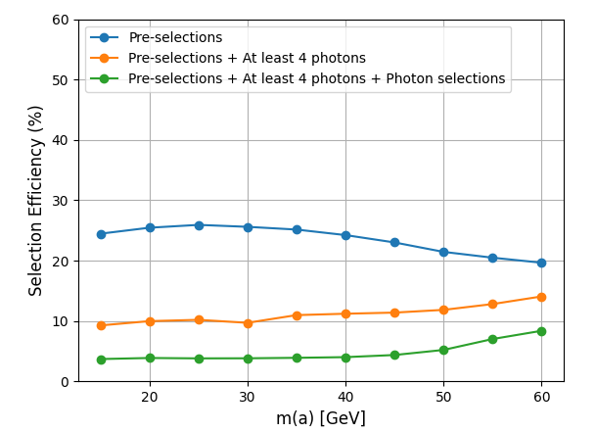
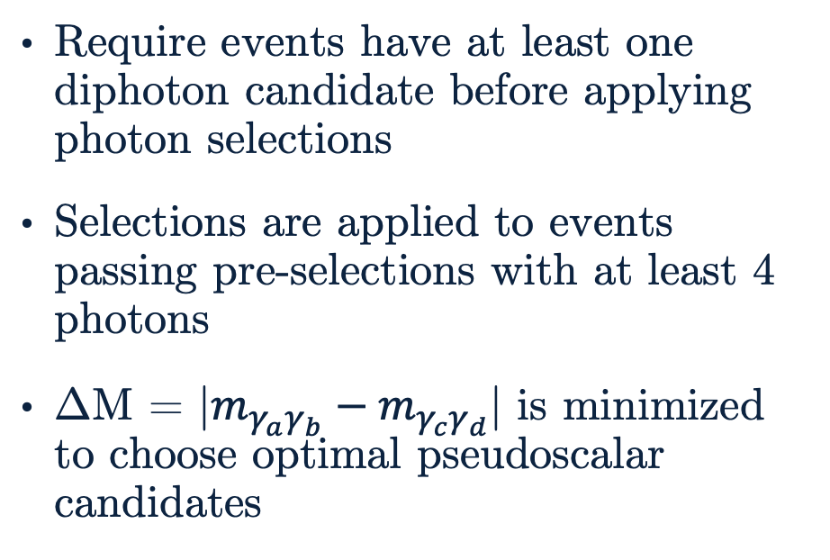
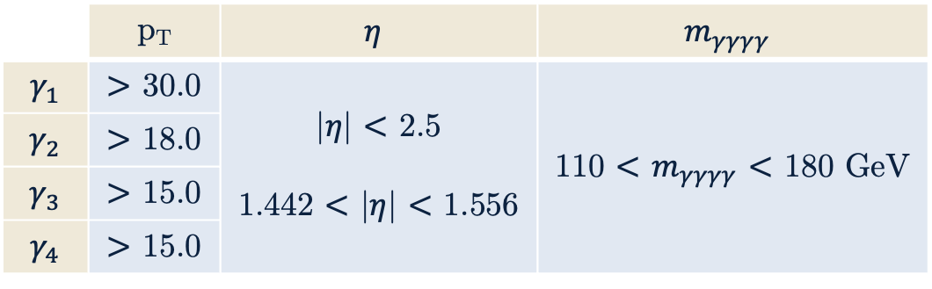
Photon Selections
Require events have at least one diphoton candidate before applying photon selections
Selections are applied to events passing pre-selections with at least 4 photons
ΔM = |$m_{γ_{a}γ_{b}}−m_{γ_{c}γ_{d}}$| is minimized to choose optimal pseudoscalar candidates
 | p_{T} | $$η$$ | $$m_{γγγγ}$$
$$γ_{1}$$ | $>$ 30.0 | |$η$| $<$ 2.5 1.442 $<$ |$η$| $<$ 1.556 | 110 $<$ $m_{γγγγ}$ $<$ 180 GeV
$$γ_{2}$$ | $>$ 18.0
$$γ_{3}$$ | $>$ 15.0
$$γ_{4}$$ | $>$ 15.0
Above: Efficiencies of selections at various stages of selections for all nominal pseudoscalar mass points. This should improve at higher mass points.
Left: Additional selections applied to photons passing pre-selections.

Slide 14
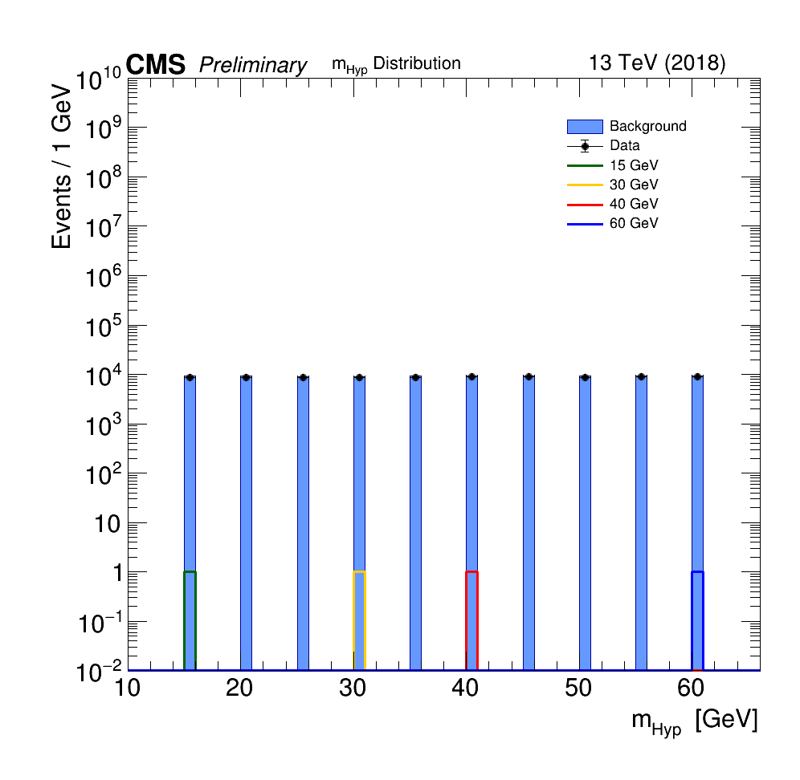
Event Selection BDT
What is a BDT?
Boosted Decision Tree
Combination of many weak learners (trees) into a strong classifier
Need a BDT to better distinguish signal-like events from background-like events
One event selection BDT model is produced for all mass points, made possible by using a constructed variable: hypothesis mass or m_{Hyp}
Right: Distribution of m_{Hyp} for signal MC of several nominal mass points, event mixed background, and data. m_{Hyp} has the associated value for a given pseudoscalar mass point for signal MC but a flat distribution for event mixed background and data, by construction.

Slide 15
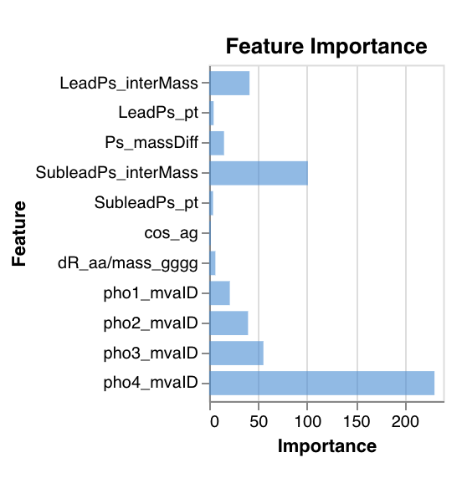
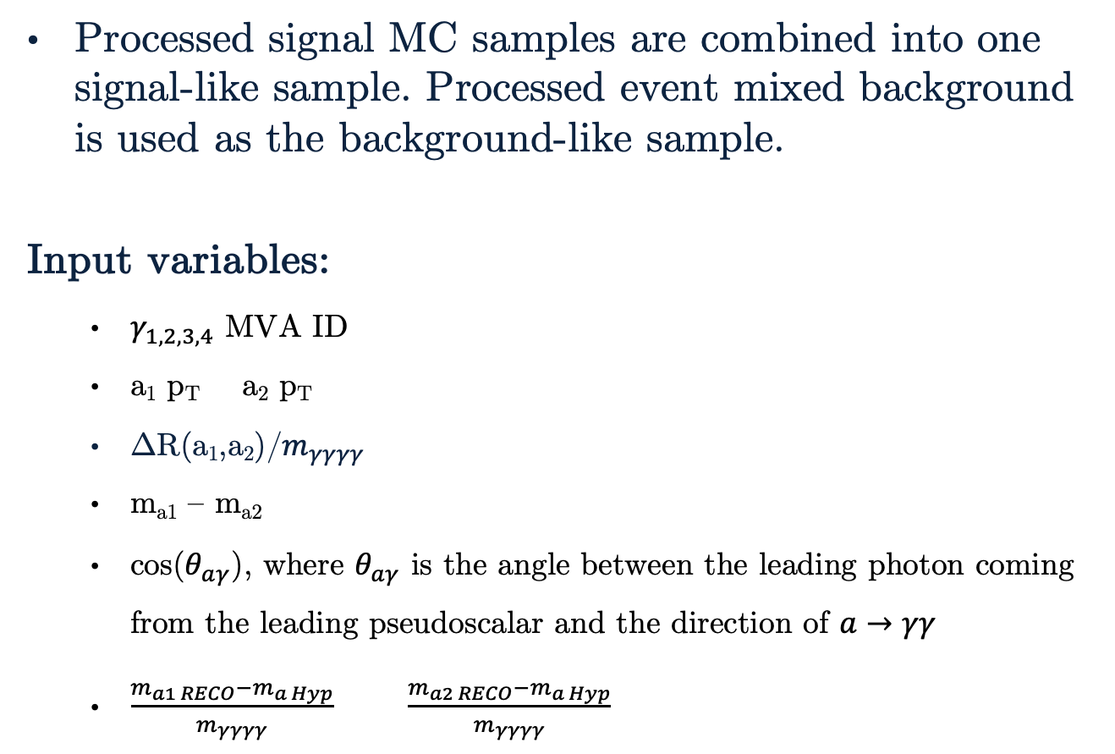
Inputs
Processed signal MC samples are combined into one signal-like sample. Processed event mixed background is used as the background-like sample.
Input variables:
$γ_{1,2,3,4}$ MVA ID
a₁ p_{T} a₂ p_{T}
ΔR(a₁,a₂)/$m_{γγγγ}$
m_{a1} – m_{a2}
cos($θ_{aγ}$), where $θ_{aγ}$ is the angle between the leading photon coming from the leading pseudoscalar and the direction of $a→γγ$
$\frac{m_{a1 RECO}−m_{a Hyp}}{m_{γγγγ}}$ $\frac{m_{a2 RECO}−m_{a Hyp}}{m_{γγγγ}}$
Above: Chart of feature importance for the event selection BDT input variables from one of the best performing models.

Slide 16
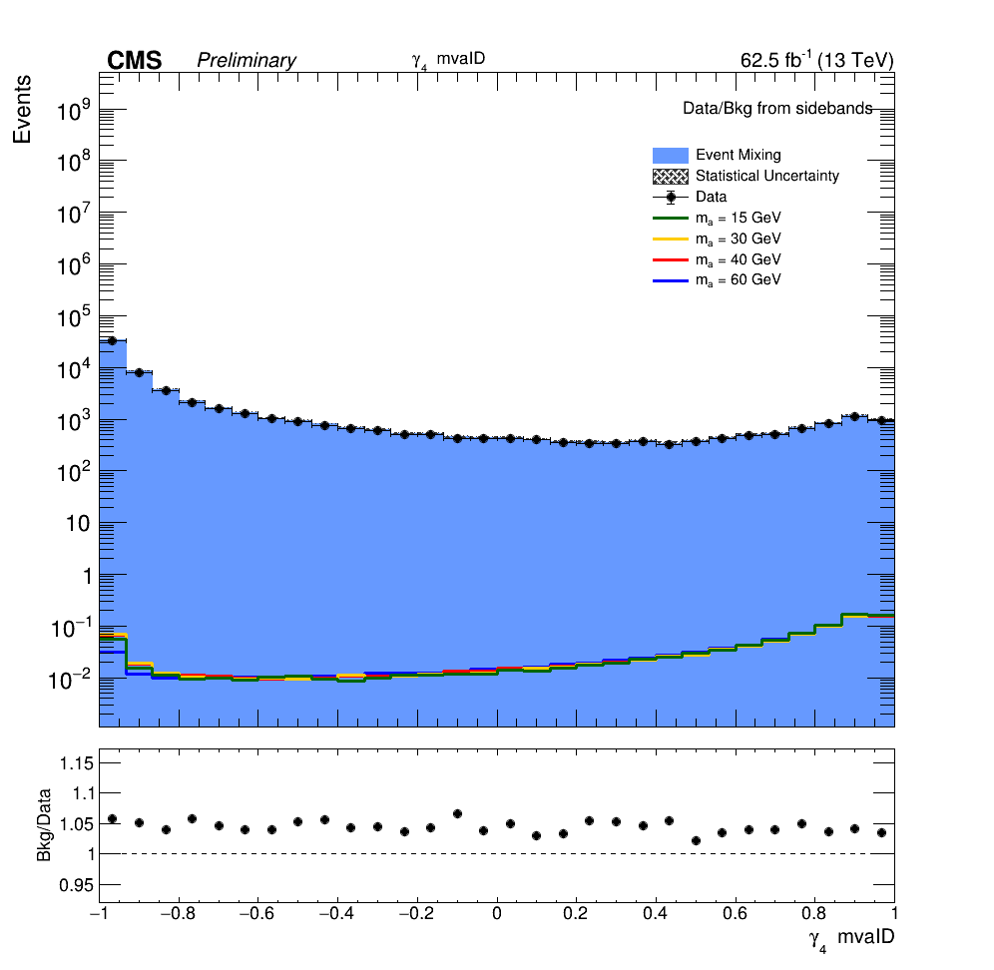
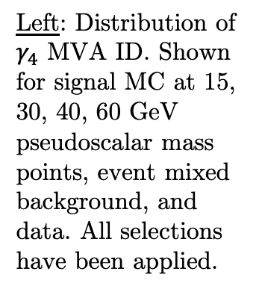
Important Input Variables
Left: Distribution of $γ_{4}$ MVA ID. Shown for signal MC at 15, 30, 40, 60 GeV pseudoscalar mass points, event mixed background, and data. All selections have been applied.
Above: Chart of feature importance for the event selection BDT input variables from one of the best performing models.

Slide 17
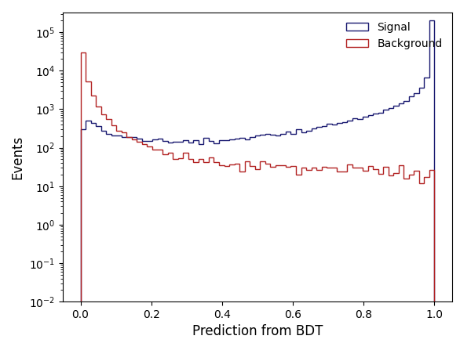
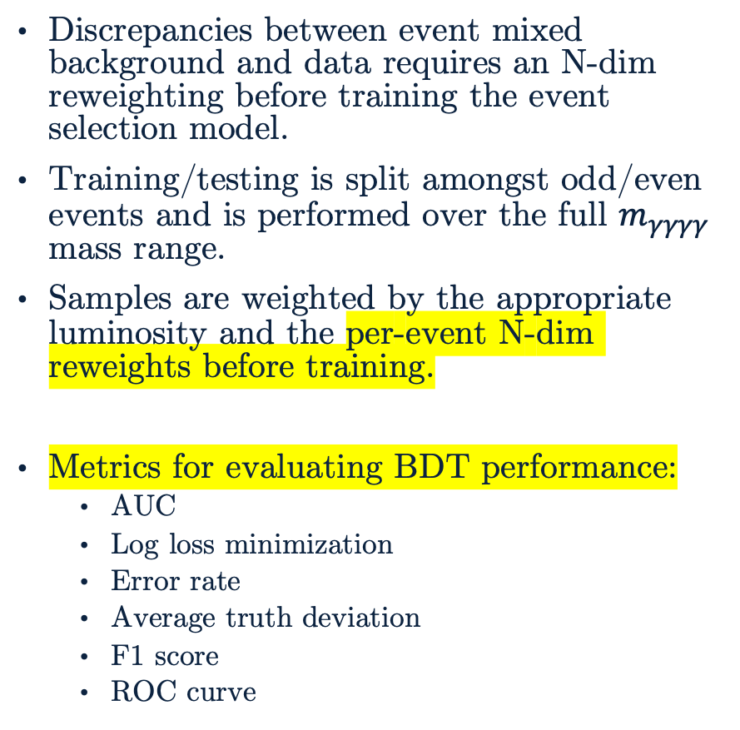
Training the Event Selection BDT
Discrepancies between event mixed background and data requires an N-dim reweighting before training the event selection model.
Training/testing is split amongst odd/even events and is performed over the full $m_{γγγγ}$ mass range.
Samples are weighted by the appropriate luminosity and the per-event N-dim reweights before training.
Metrics for evaluating BDT performance:
AUC
Log loss minimization
Error rate
Average truth deviation
F1 score
ROC curve
Above: Event selection BDT predictions for training set using processed signal MC and event mixed background.

Slide 18
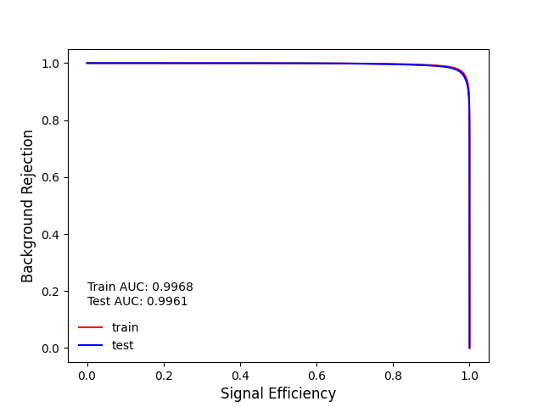
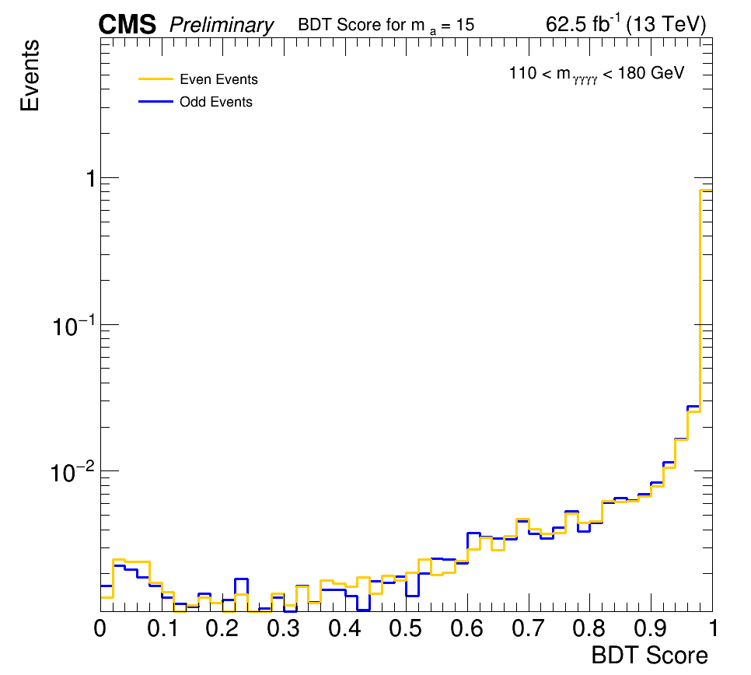
Checking the Event Selection BDT
Checks for overtraining are done to ensure an optimal event selection model is produced.
ROC checks can be done for the entire model at once and even/odd checks must be done by nominal mass point.
Above: ROC curve for one of the best event selection BDT models. A match between train/test curves and their associated area under curve (AUC) indicates a lack of overtraining.
Left: Overtraining check by comparing prediction distribution of trained event selection BDT model for m_{a} = 15 GeV. Odd/even (train/test) samples should have a similar distribution which would indicate a lack of overtraining.

Slide 19
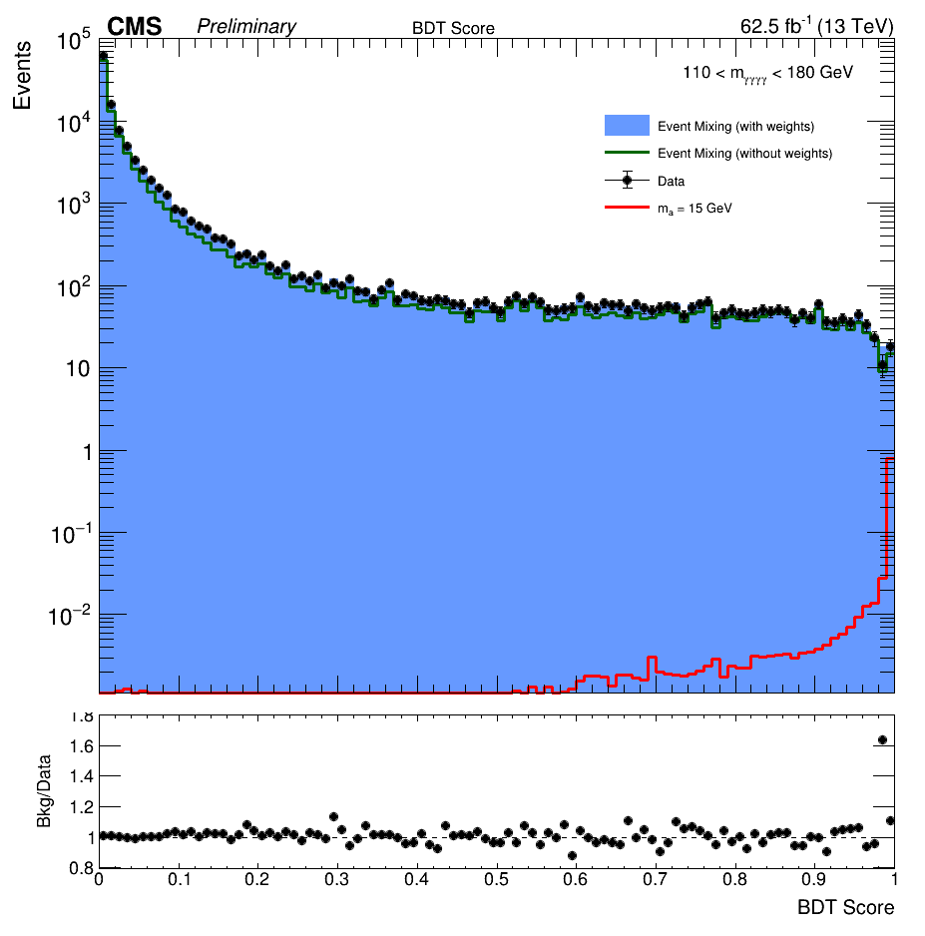
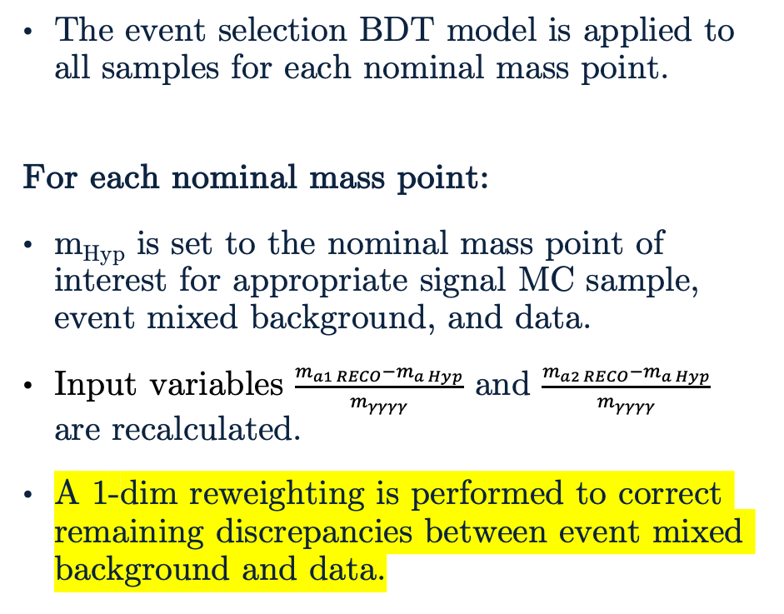
Event Selection BDT
The event selection BDT model is applied to all samples for each nominal mass point.
For each nominal mass point:
m_{Hyp} is set to the nominal mass point of interest for appropriate signal MC sample, event mixed background, and data.
Input variables $\frac{m_{a1 RECO}−m_{a Hyp}}{m_{γγγγ}}$ and $\frac{m_{a2 RECO}−m_{a Hyp}}{m_{γγγγ}}$ are recalculated.
A 1-dim reweighting is performed to correct remaining discrepancies between event mixed background and data.
Right: Distribution of event selection BDT score for signal MC, event mixed background, data for m_{a} = 15 GeV. The pre-reweighting event mixed background distribution is shown.

Slide 20
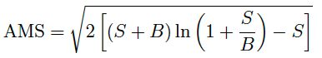
BDT Score Categorization
The goal of the event selection procedure is to maximize significance of the analysis. Approximate Mean Significance (AMS) is defined as:
where S and B reference to the number of signal and background events, respectively.
The BDT score distributions for signal MC, event mixed background, and data are smoothed for each nominal mass point to account for statistical fluctuations when using very fine binning.
Category boundaries are optimized to maximize total AMS in the signal region while requiring at least 8 data events in the sideband region.
In the case of multiple categories, AMS is added in quadrature.

Slide 21
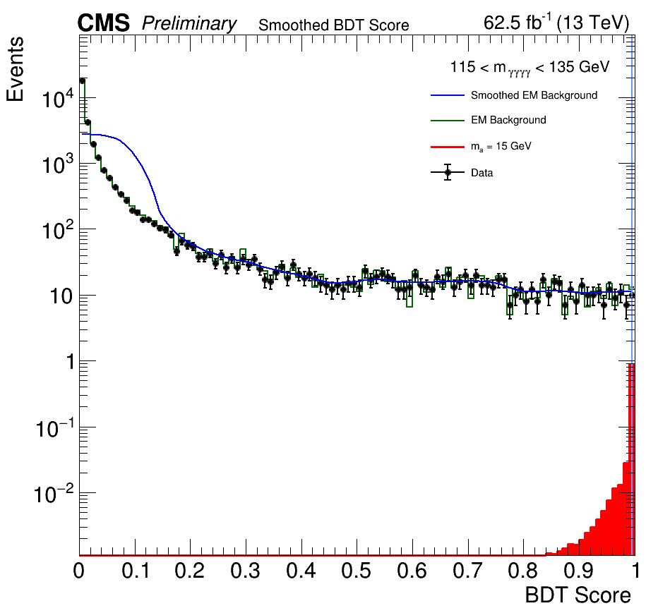
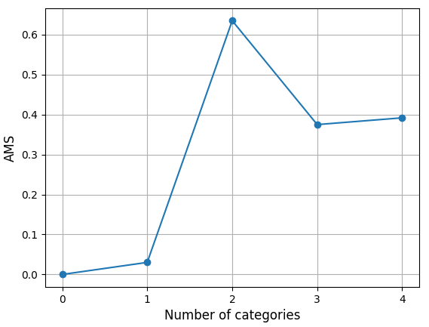
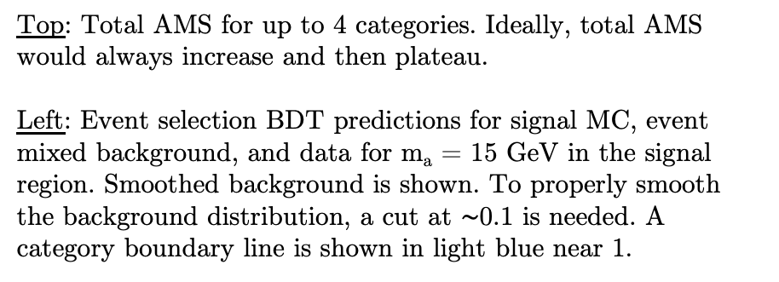
BDT Score Categorization
Top: Total AMS for up to 4 categories. Ideally, total AMS would always increase and then plateau.
Left: Event selection BDT predictions for signal MC, event mixed background, and data for m_{a} = 15 GeV in the signal region. Smoothed background is shown. To properly smooth the background distribution, a cut at $∼$0.1 is needed. A category boundary line is shown in light blue near 1.

Slide 22
Outline
The Standard Model and Beyond
LHC and CMS
Introduction to Analysis
Sample Generation
Event Selection
Statistical Analysis
Advancements on Previous Studies
Summary
Notes:
Introduction – what am I doing? Basic why is it interesting?
The Standard Model and Beyond – theory stuff
LHC and CMS – also mention service work here briefly
Sample Generation – signal MC and event mixing part
Event Selection – cuts, BDT, categorization
Statistical Analysis – signal modelling + note on background fits
Advancements on Previous Studies – exactly what it sounds like
Summary – put everything together for questions
REMEMBER TO INCLUDE PLOTS!!!!!!!

Slide 23
Statistical Analysis
Signal modelling for nominal mass points (plot(s)!)
Intermediate mass points – to do (talk about this?)
Note about background modelling as nuisance parameter when extracting limits? (Backup?)
To do stuff, e.g., limit extraction

Slide 24
Outline
The Standard Model and Beyond
LHC and CMS
Introduction to Analysis
Sample Generation
Event Selection
Statistical Analysis
Advancements on Previous Studies
Summary
Notes:
Introduction – what am I doing? Basic why is it interesting?
The Standard Model and Beyond – theory stuff
LHC and CMS – also mention service work here briefly
Sample Generation – signal MC and event mixing part
Event Selection – cuts, BDT, categorization
Statistical Analysis – signal modelling + note on background fits
Advancements on Previous Studies – exactly what it sounds like
Summary – put everything together for questions
REMEMBER TO INCLUDE PLOTS!!!!!!!

Slide 25
Advancements on Previous Studies
How to improve on the previous analysis…
More statistics if doing a Run 2 + partial Run 3
Deep learning model instead of a BDT (Keras network vs tree)
Better with lower-level variables. Still might be possible given the work done to add extra branches to the samples anyway
Improvement by sqrt(2) in precision from Run 2 → Run 3

Slide 26
Outline
The Standard Model and Beyond
LHC and CMS
Introduction to Analysis
Sample Generation
Event Selection
Statistical Analysis
Advancements on Previous Studies
Summary
Notes:
Introduction – what am I doing? Basic why is it interesting?
The Standard Model and Beyond – theory stuff
LHC and CMS – also mention service work here briefly
Sample Generation – signal MC and event mixing part
Event Selection – cuts, BDT, categorization
Statistical Analysis – signal modelling + note on background fits
Advancements on Previous Studies – exactly what it sounds like
Summary – put everything together for questions
REMEMBER TO INCLUDE PLOTS!!!!!!!

Slide 27
Summary
Do this last?

Slide 28
Thank You!

Slide 29
Backup

Slide 30
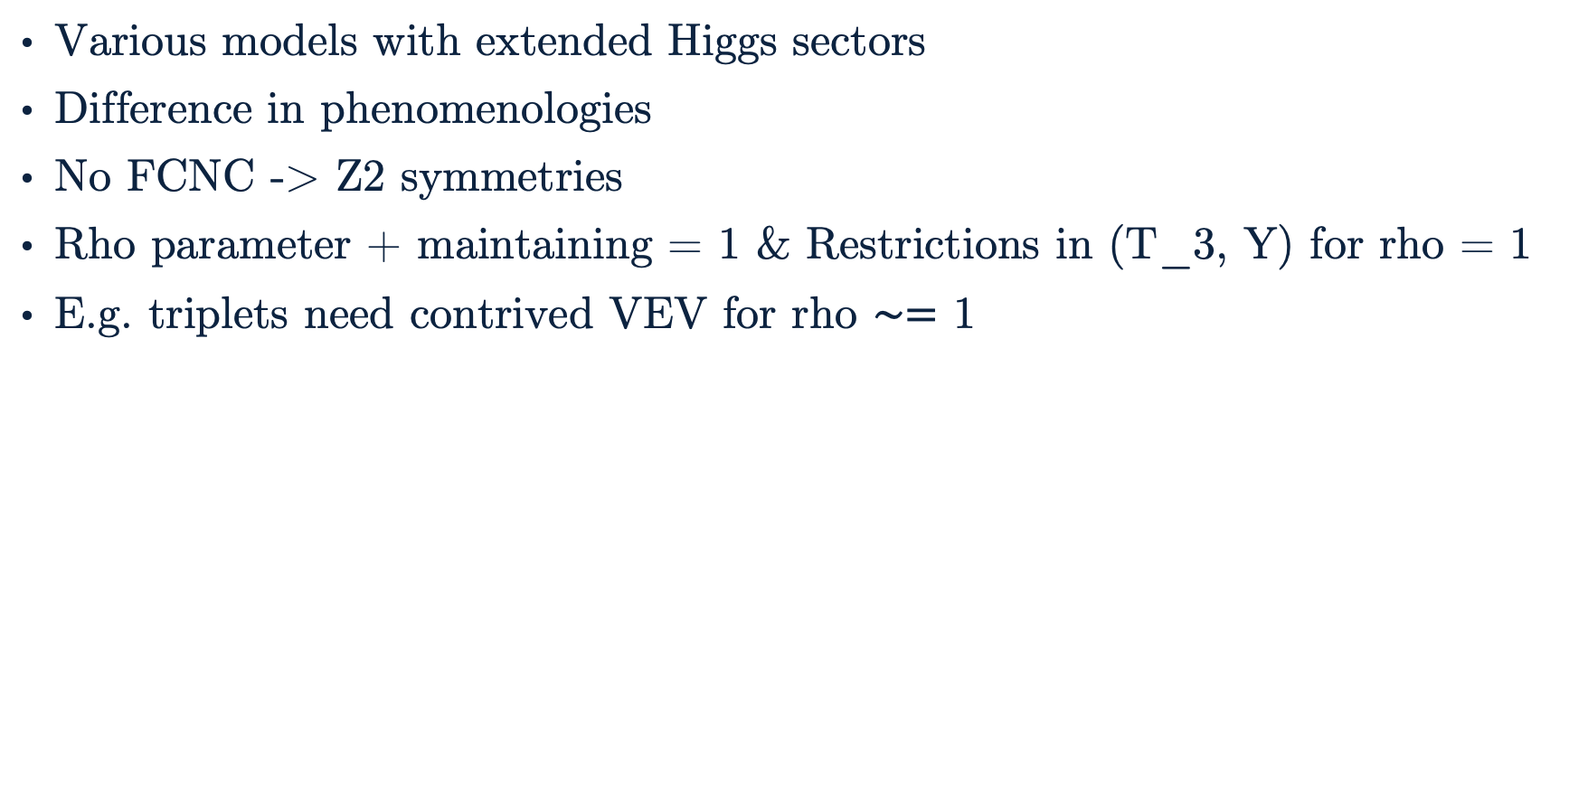
Extended Higgs Sectors
Various models with extended Higgs sectors
Difference in phenomenologies
No FCNC -> Z2 symmetries
Rho parameter + maintaining = 1 & Restrictions in (T_3, Y) for rho = 1
E.g. triplets need contrived VEV for rho $∼=$ 1

Slide 31
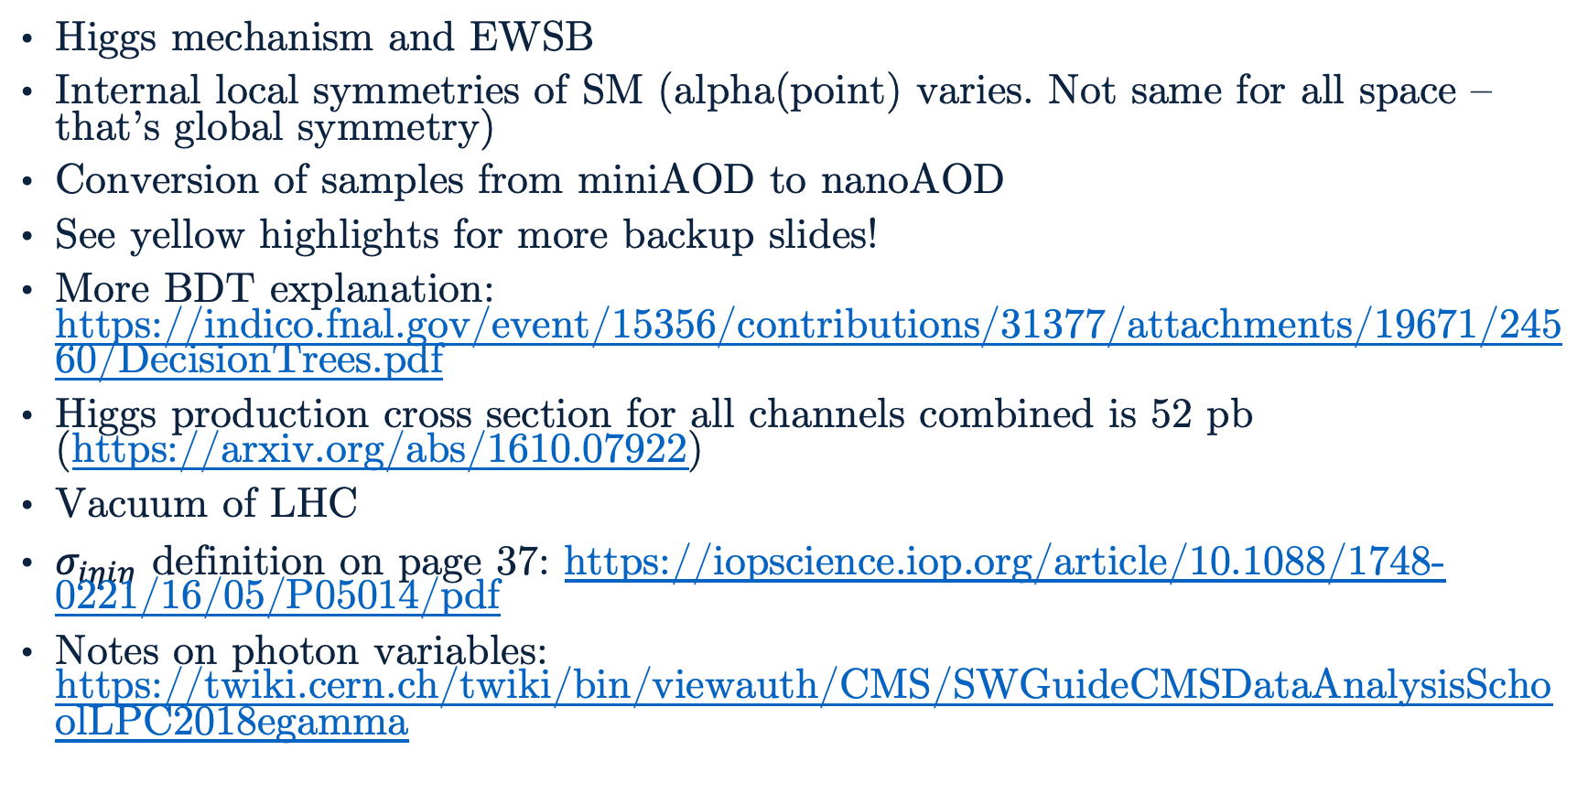
Backup Slide #1
Higgs mechanism and EWSB
Internal local symmetries of SM (alpha(point) varies. Not same for all space – that’s global symmetry)
Conversion of samples from miniAOD to nanoAOD
See yellow highlights for more backup slides!
More BDT explanation: https://indico.fnal.gov/event/15356/contributions/31377/attachments/19671/24560/DecisionTrees.pdf
Higgs production cross section for all channels combined is 52 pb (https://arxiv.org/abs/1610.07922)
Vacuum of LHC
$σ_{iηiη}$ definition on page 37: https://iopscience.iop.org/article/10.1088/1748-0221/16/05/P05014/pdf
Notes on photon variables: https://twiki.cern.ch/twiki/bin/viewauth/CMS/SWGuideCMSDataAnalysisSchoolLPC2018egamma

Slide 32
Analysis Overview
nanoAOD v9
w/ extra branches*
HiggsDNA
BDT Training
BDT Categories
Signal MC
Event Mixed
Background
Data
Low mass diphoton selections
N-dim reweighting of samples for BDT training
Process samples with BDT model
1-dim reweighting of BDT scores
Photon selections
Training event selection BDT
Optimize and cut on categories
*extra branches listed in backup
Signal Modelling
Next Steps…
Fit signal samples

Slide 33
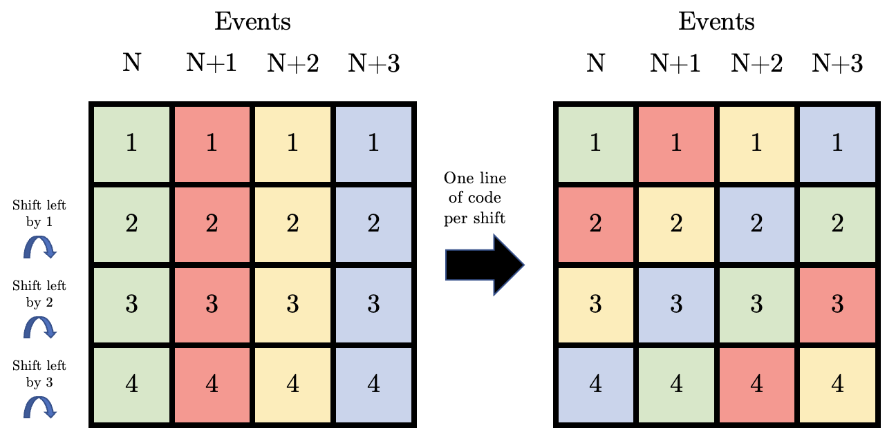
Event Mixing
Expected shuffling:
Events are color coded and then shuffled.
How to read: Event N has photon N → event N, photon 2 → event N+1, etc.
Observed shuffling:
Photon 1 (Evt 1) → Photon 1 (Evt 1)
Photon 2 (Evt 1) → Photon 2 (Evt 2)
Photon 3 (Evt 1) → Photon 3 (Evt 3)
Photon 4 (Evt 1) → Photon 4 (Evt 4)
And so on for the other events…

